Slide 1
Open Digital Learning
Dr. Charles Severance
www.dr-chuck.com
www.tsugi.org/workshop.txt

Slide 2
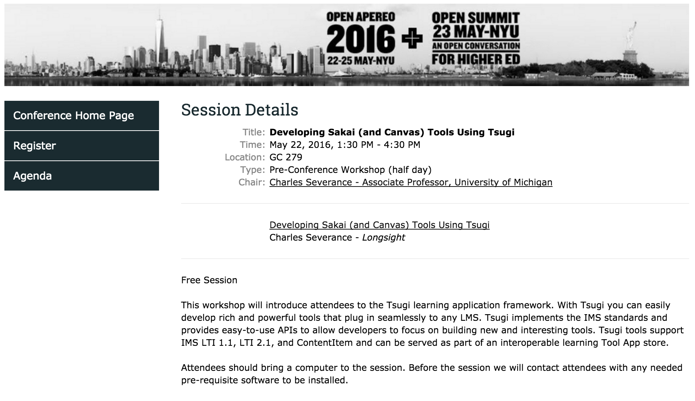

Slide 3
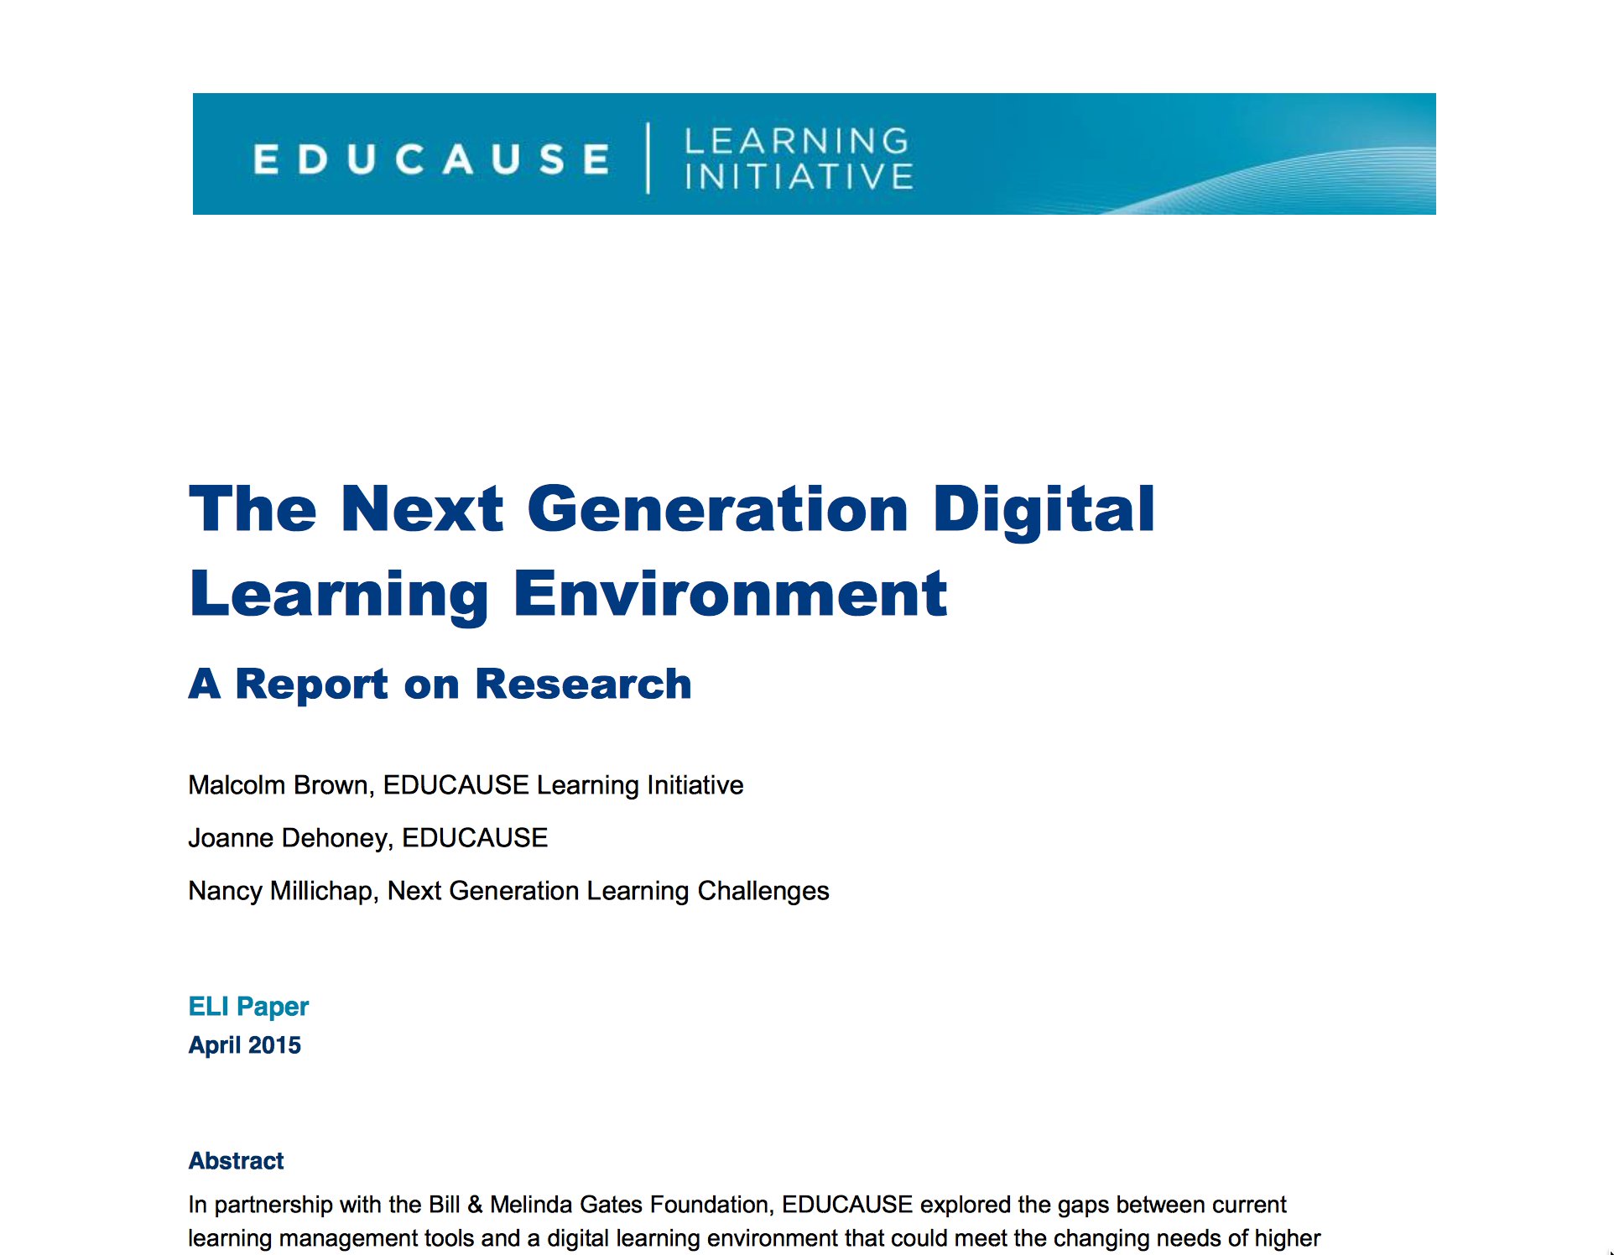
https://net.educause.edu/ir/library/pdf/eli3035.pdf

Slide 4
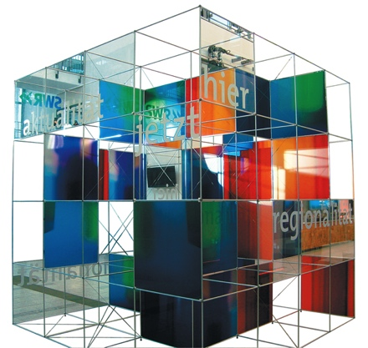
The Conclusion: The NGDLE is More Than an LMS
“An early conclusion from our research is that although the NGDLE might include a traditional LMS as a component, it will not itself be a single application like the current LMS or other enterprise applications. Rather, the NGDLE will be an ecosystem of sorts . . . “
https://net.educause.edu/ir/library/pdf/eli3035.pdf

Slide 5
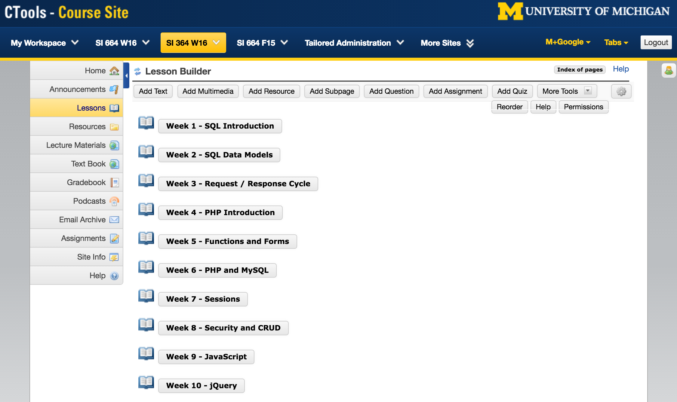

Slide 6
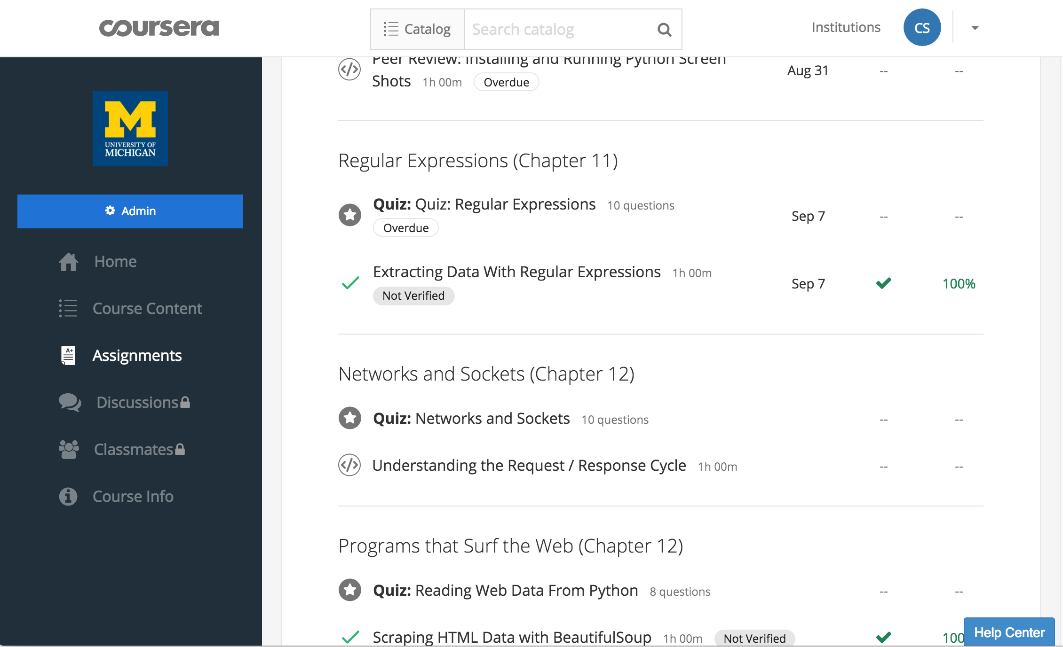

Slide 7
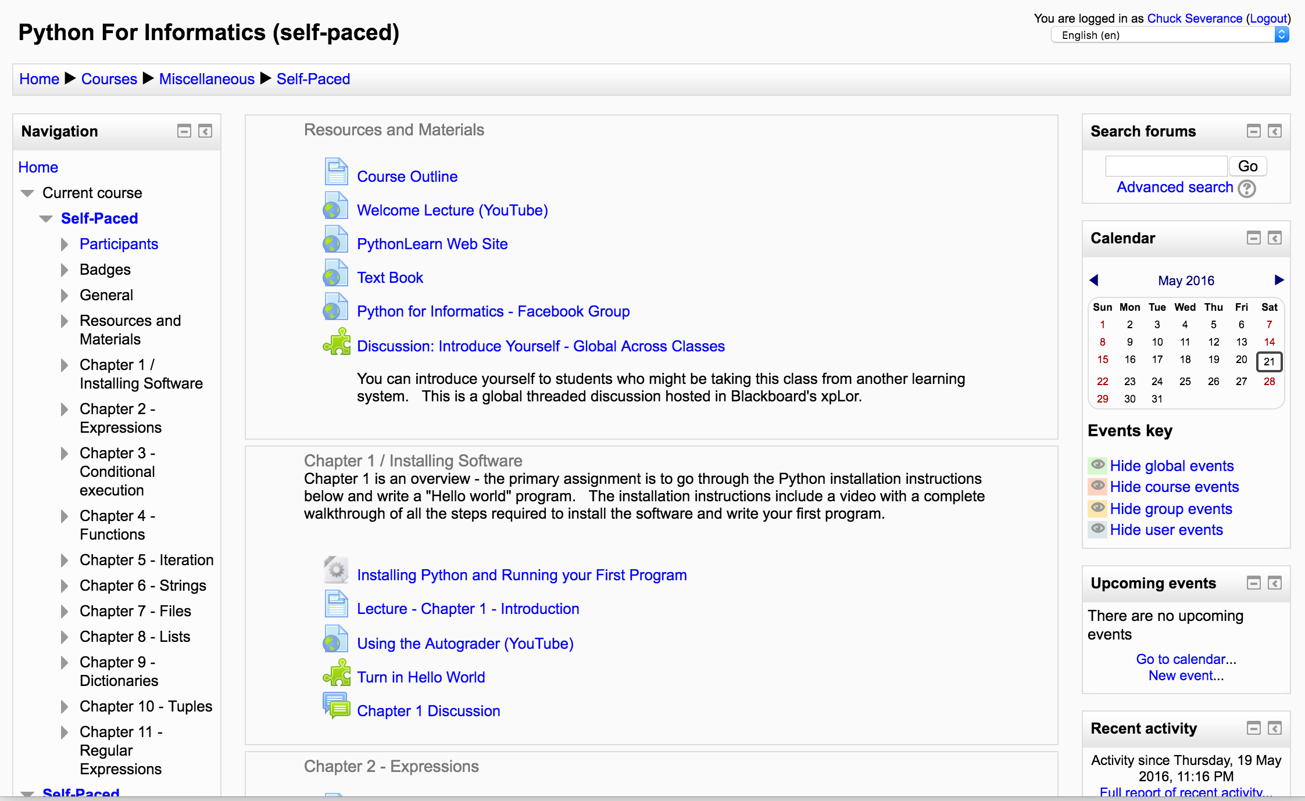

Slide 8
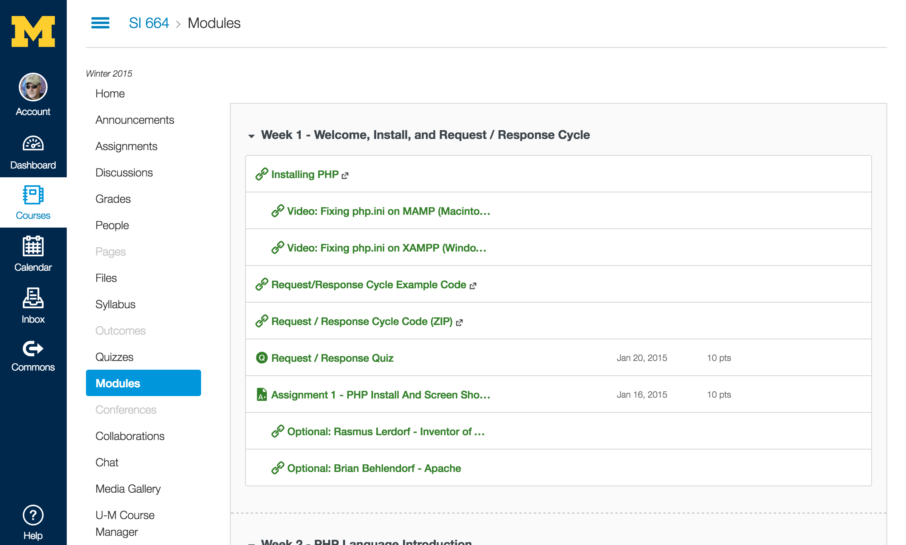

Slide 9
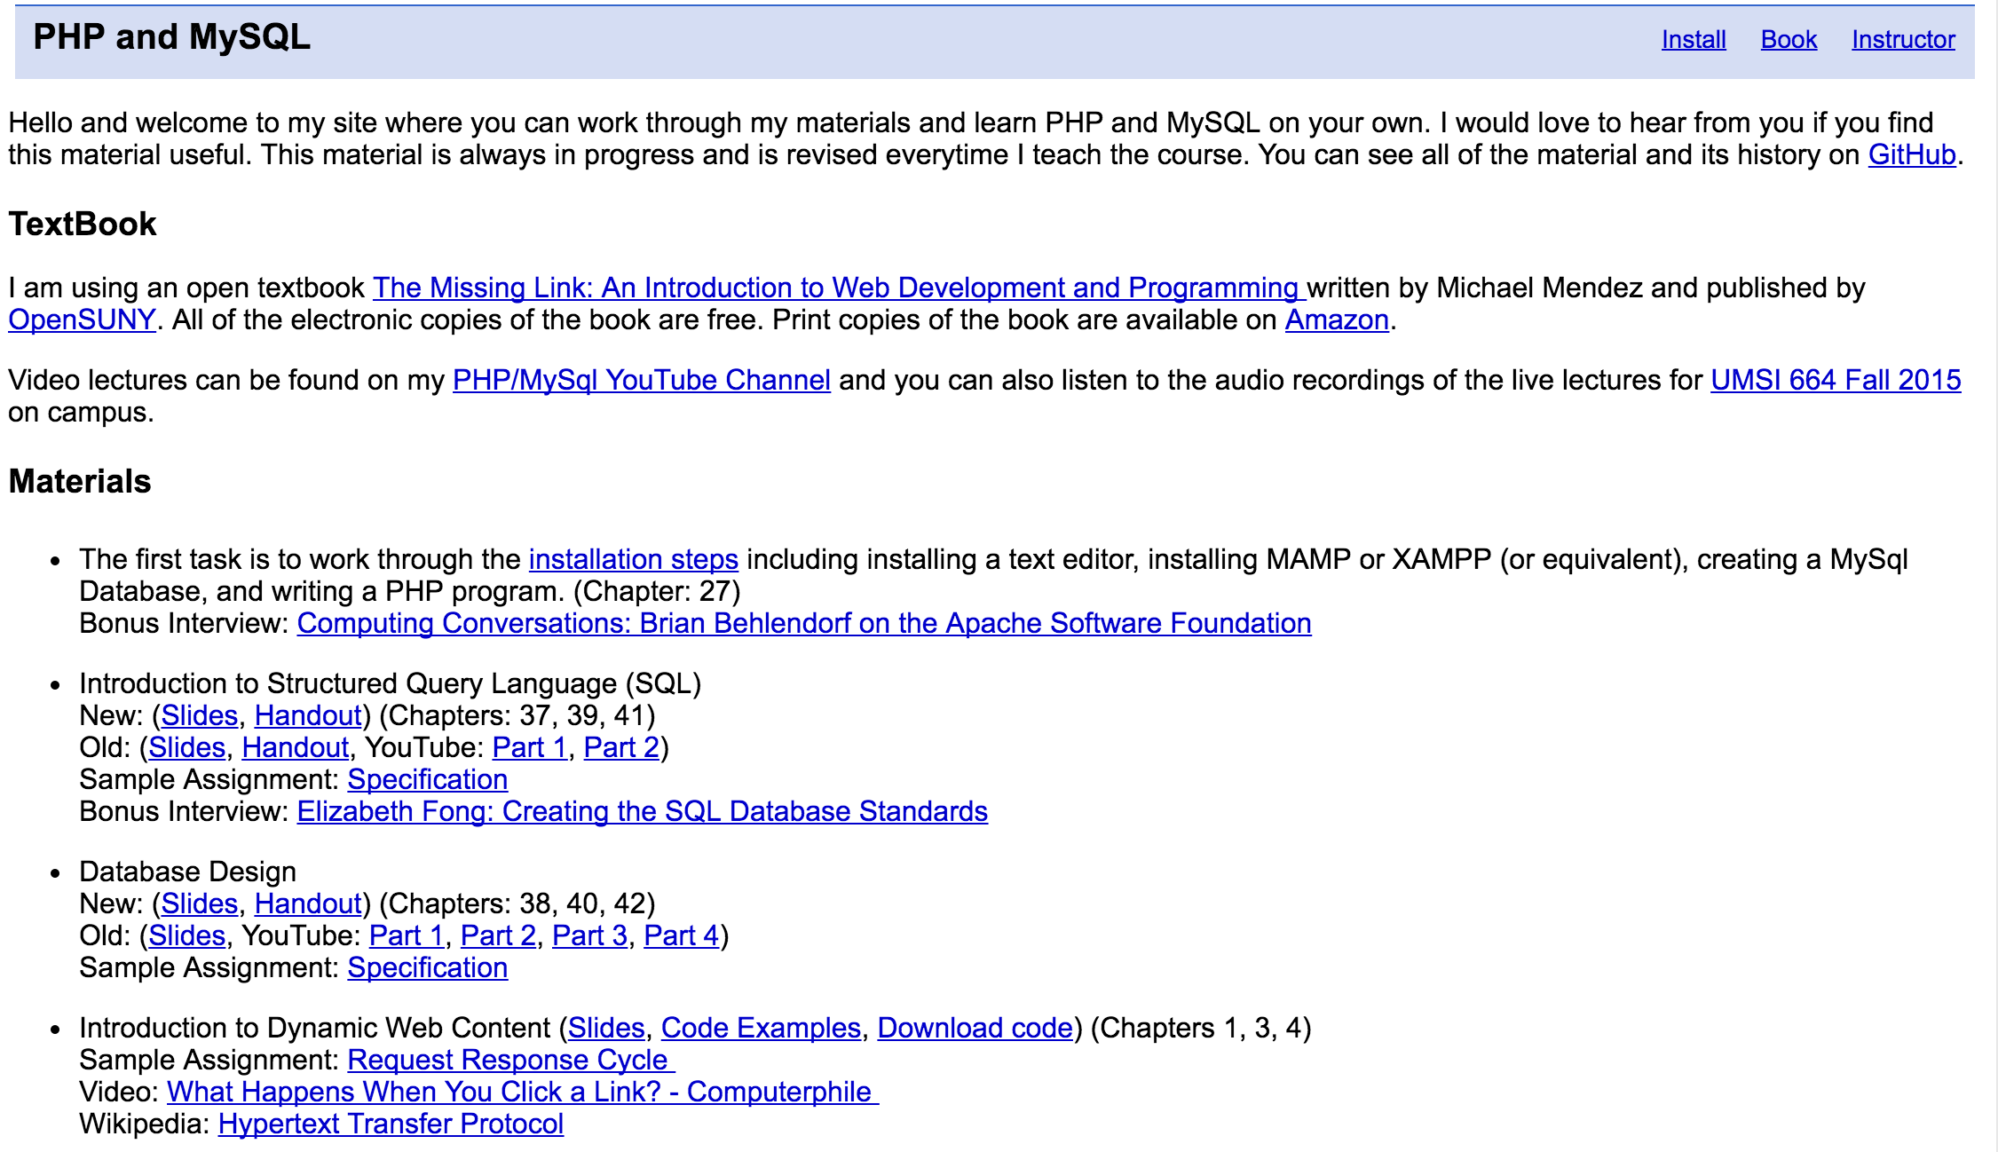

Slide 10
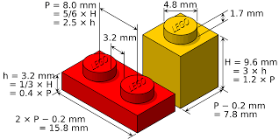
interoperability
Source: Malcolm Brown

Slide 11
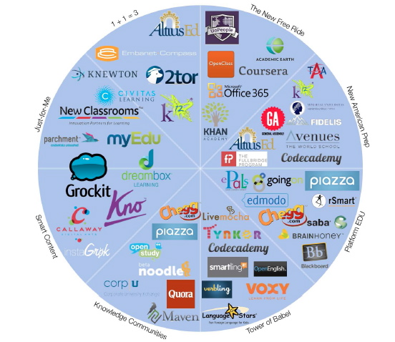
Historic
Levels of
Venture
Investment
in EdTech
Source: GSV: American
Revolution 2.0
http://gsvadvisors.com

Slide 12
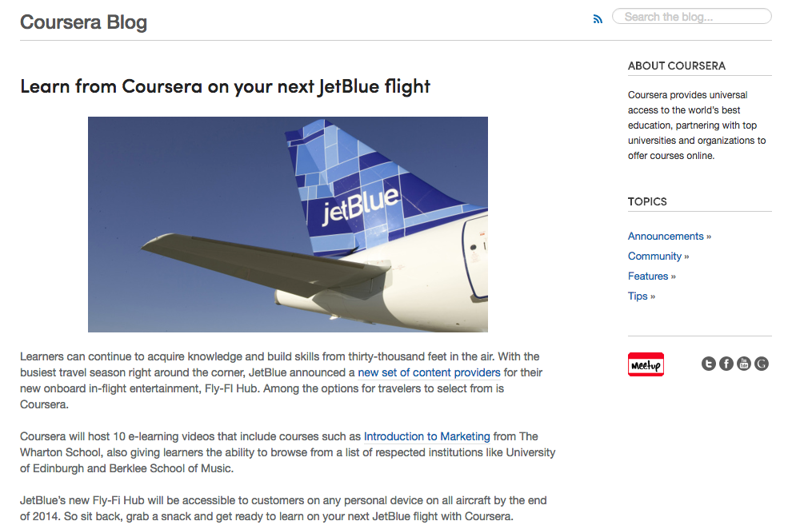
http://coursera.tumblr.com/post/103477375027/learn-from-coursera-on-your-next-jetblue-flight

Slide 13
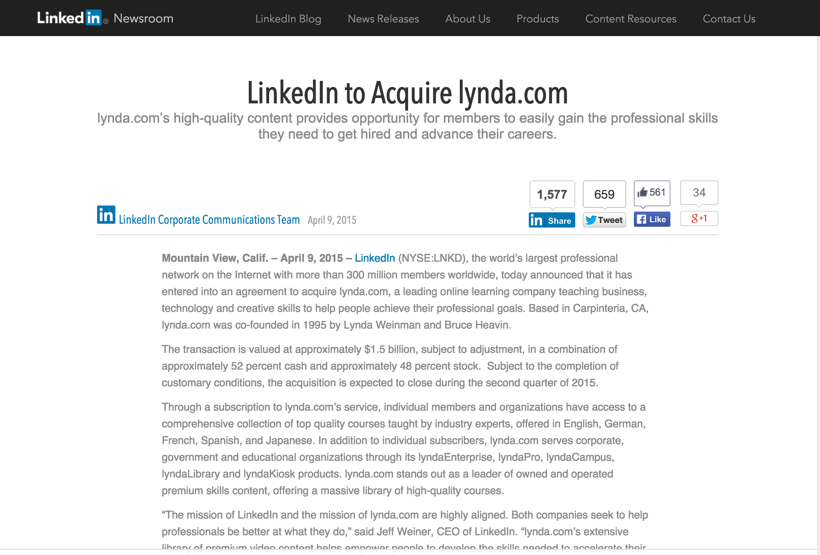
https://press.linkedin.com/site-resources/news-releases/2015/linkedin-to-acquire-lyndacom

Slide 14
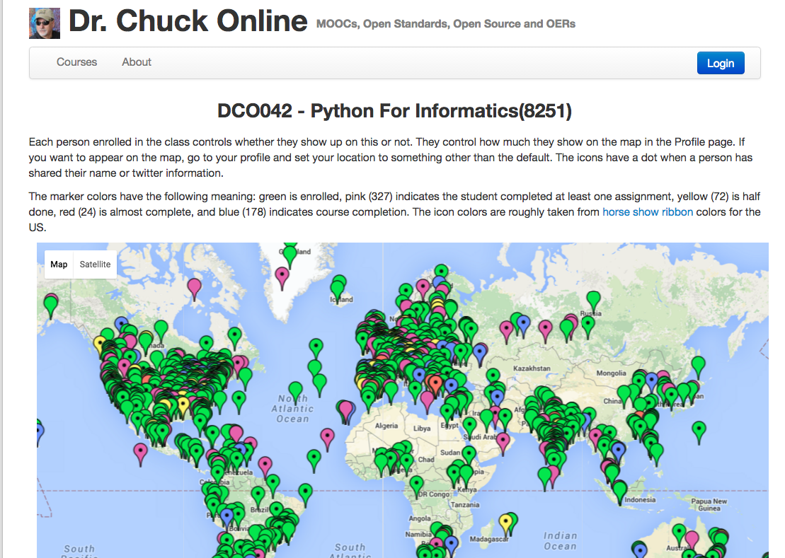

Slide 15
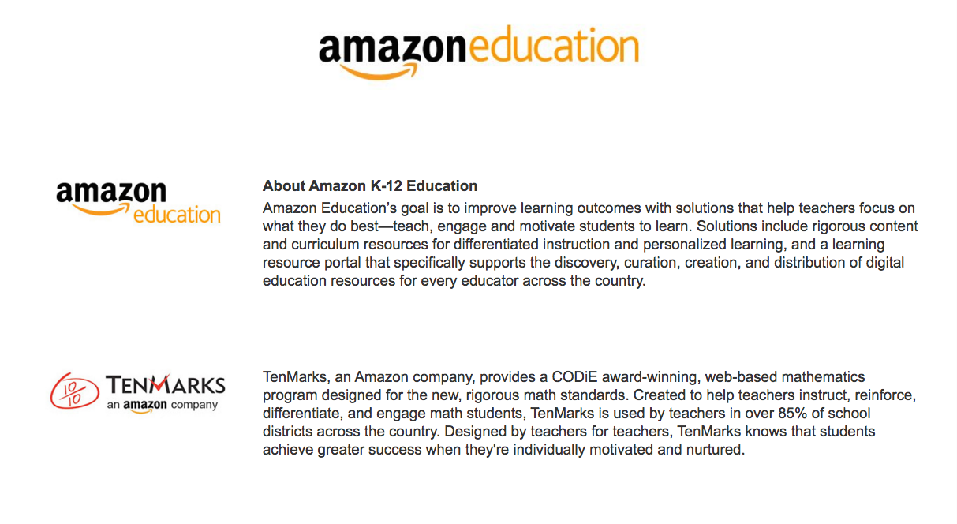

Slide 16
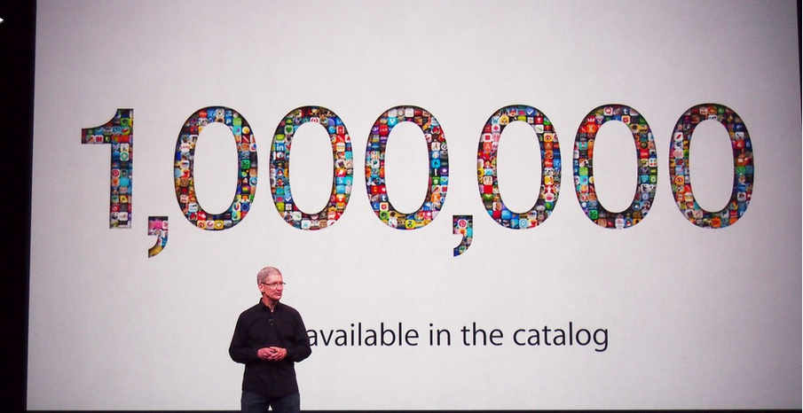
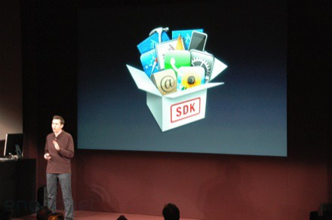
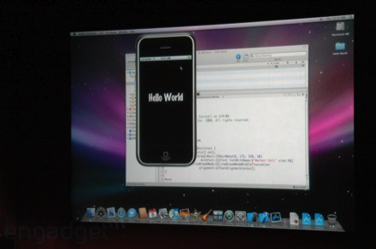
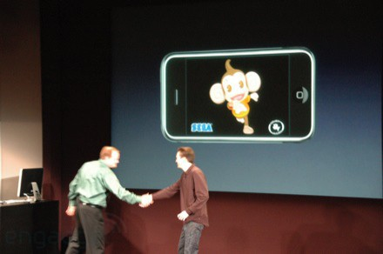
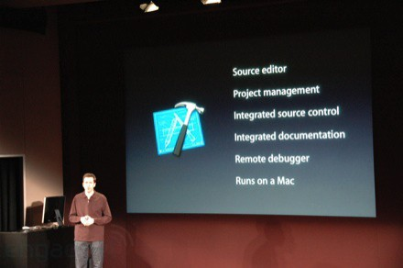
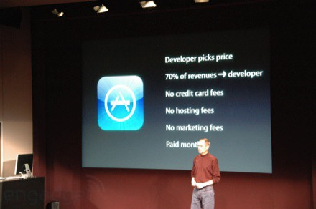
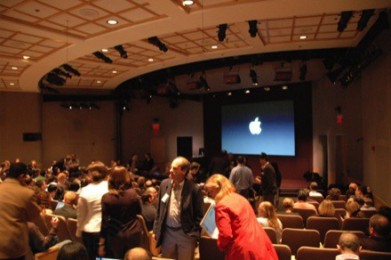
March 6, 2008 iPhone SDK Press Conference

Slide 17
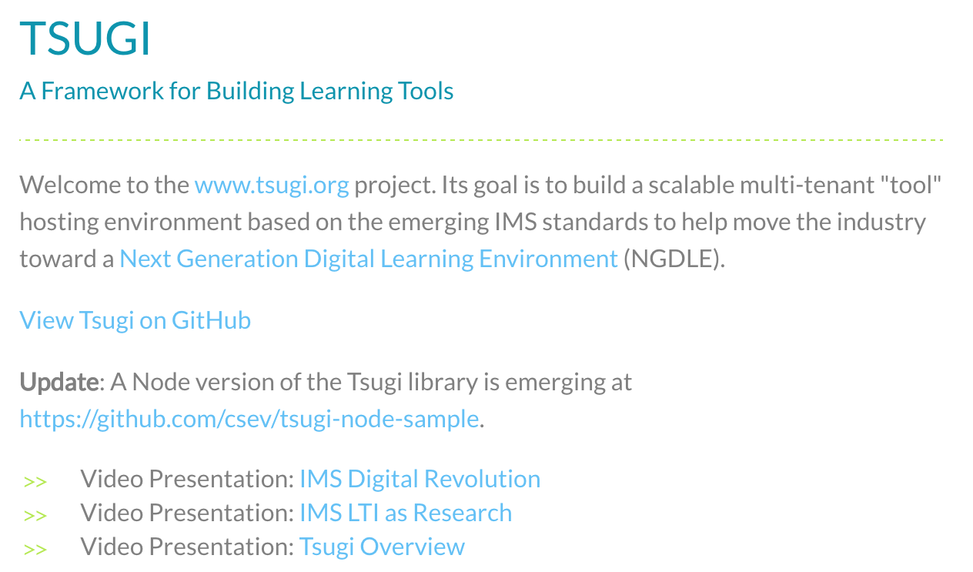
www.tsugi.org

Slide 18
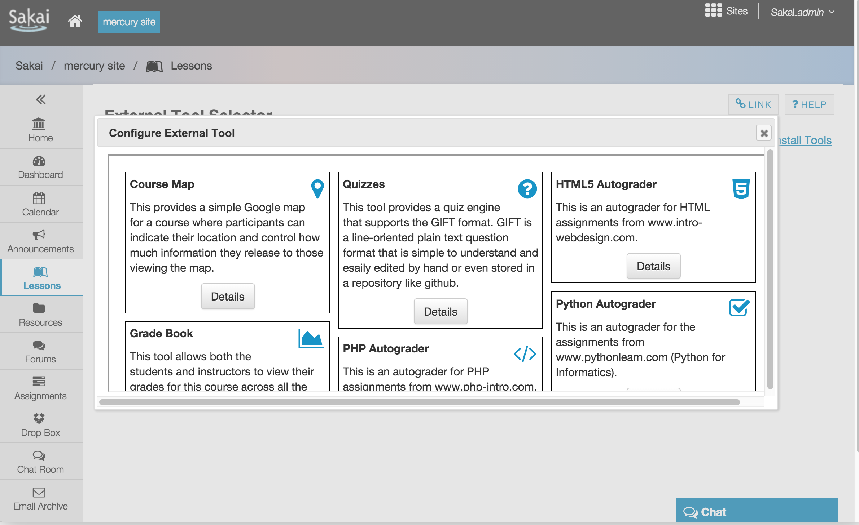

Slide 19
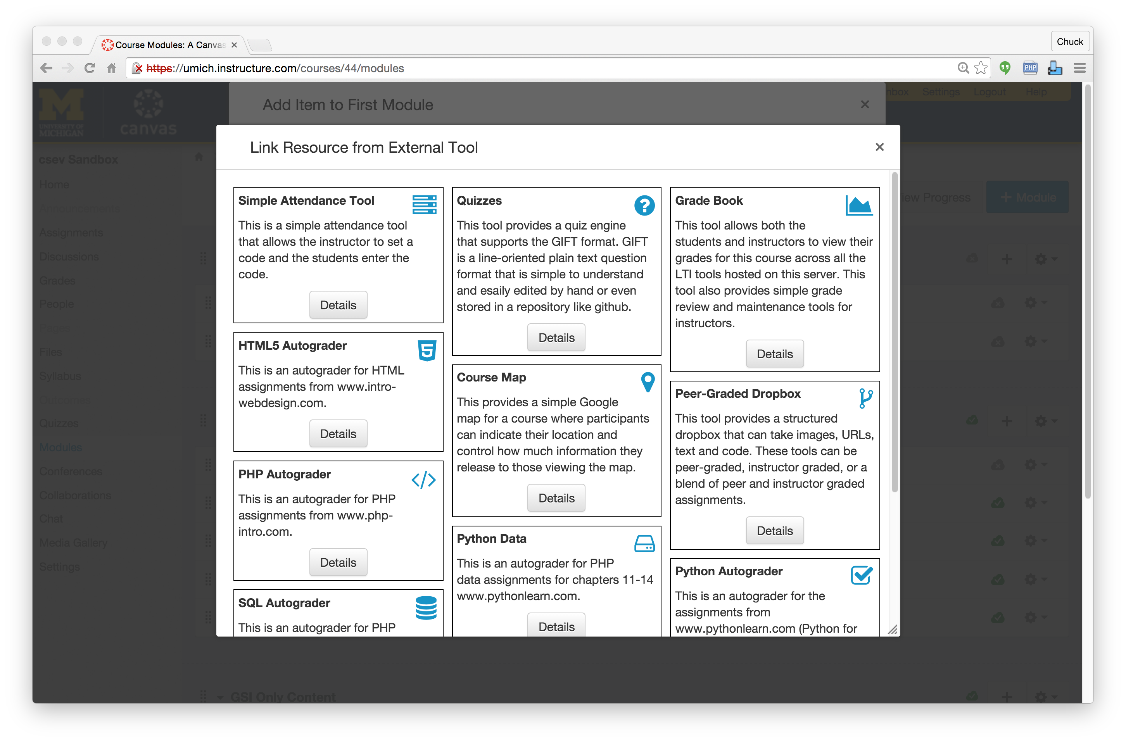

Slide 20
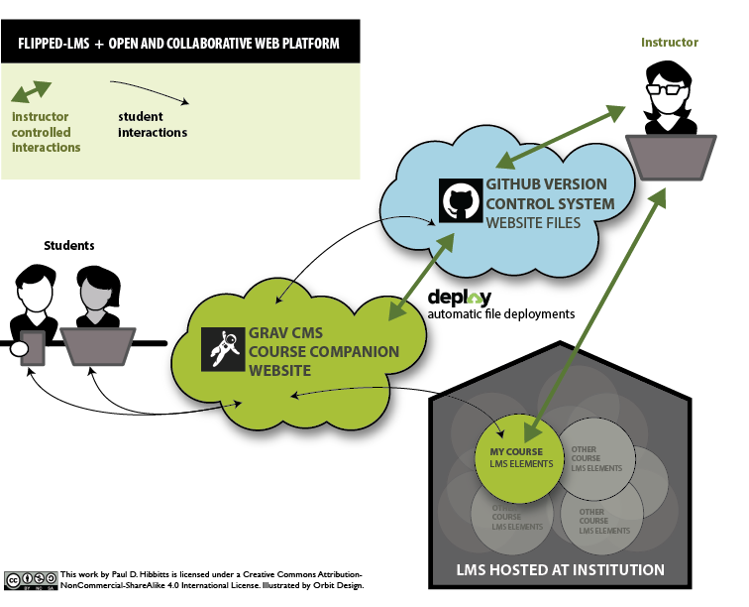
http://hibbittsdesign.org/blog/tags:Flipped-LMS
Notes:
Paul Hibbetts – University of British Columbia

Slide 21
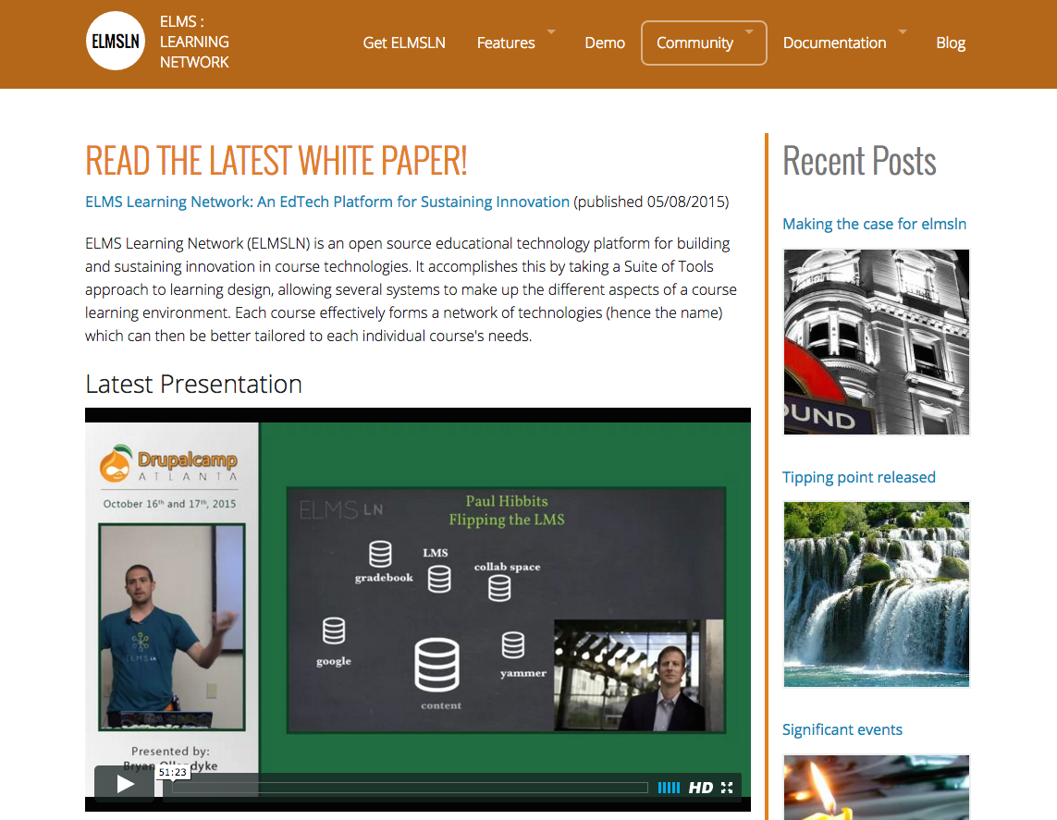
www.elmsn.org

Slide 22
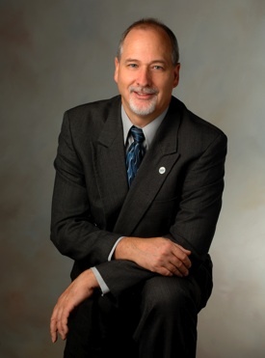



In building the NGDLE, open source will be first to market..

Slide 23
Title: Emerging Next Generation Digital Learning Environments
Time: May 24, 2016, 3:00 PM - 3:45 PM
Location: GC 279
Title: Three Takes and a Conversation: the Future of Digital Learning
Time: May 25, 2016, 9:00 AM - 10:15 AM
Location: Rosenthal Pavilion (10th Floor)
Title: Implementing the Next Generation Digital Learning Environment
Time: May 25, 2016, 11:45 AM - 12:30 PM
Location: GC 279
Type: Birds of a Feather Discussion
Title: Getting Students Involved in Open Source Software
Time: May 25, 2016, 3:00 PM - 3:45 PM
Location: GC 279

